Slide 1
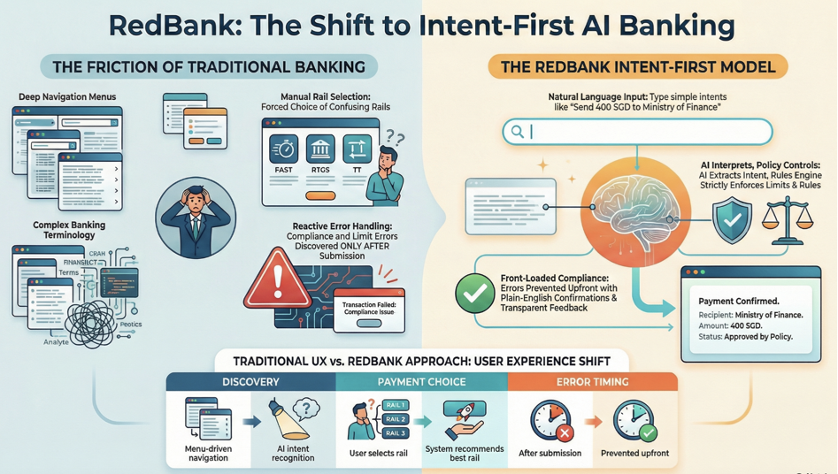

Slide 2
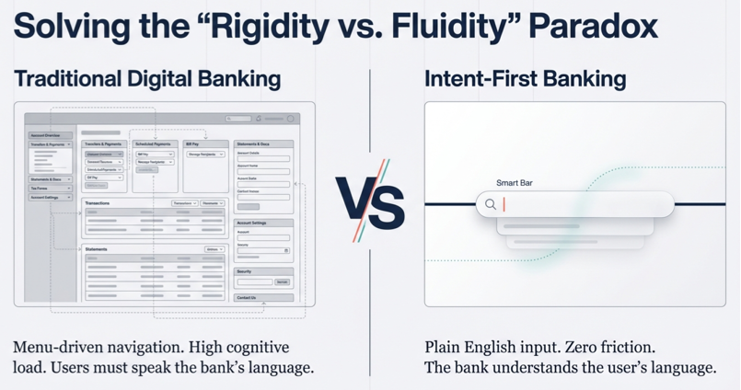
Notes:
So idea is to keep it simple.. Just smart bar.. User interacts, express in plain language ..

Slide 3
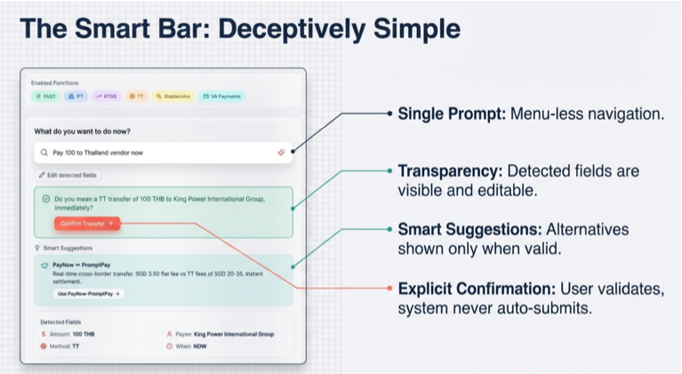

Slide 4
